Slide 1

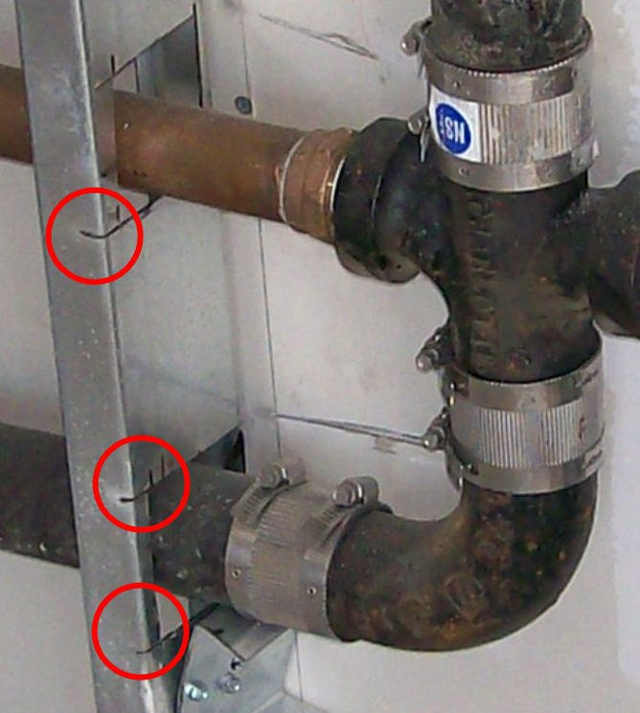
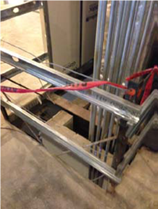
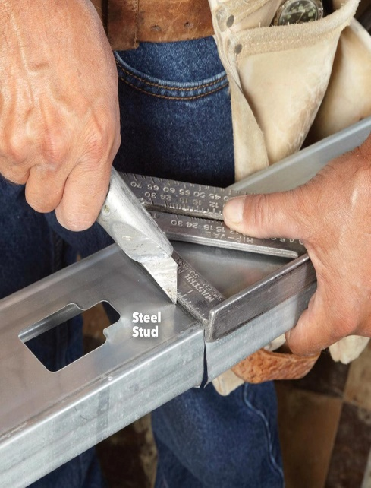

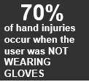
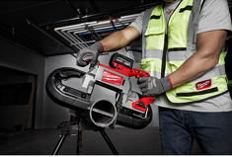
Hand Incident Prevention
Know the risk Factors:
Trade Professionals are subjected to laceration / hand injury hazards in most work environments. They can be eliminated often by planning processes and engineer controls – however the most important part of elimination is recognizing the cut hazards associated with your work and the surrounding environment. Proper tool use, right tool for the job, hand placement, and situational awareness can be a great start for eliminating hand injuries. Wearing PPE 100% of the time is also good.
Please discuss this with your crew and ask them to identify 4 hazards and precautions associated with hand incident prevention, then flip the page over and see if they identified the same things as we did. Challenge them to identify the hazards before flipping this over.

Slide 2
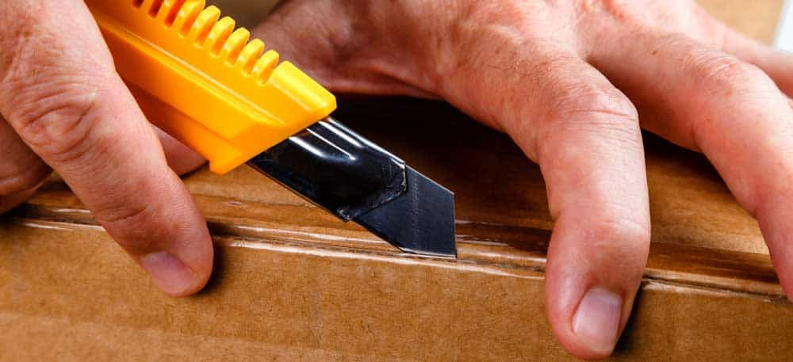
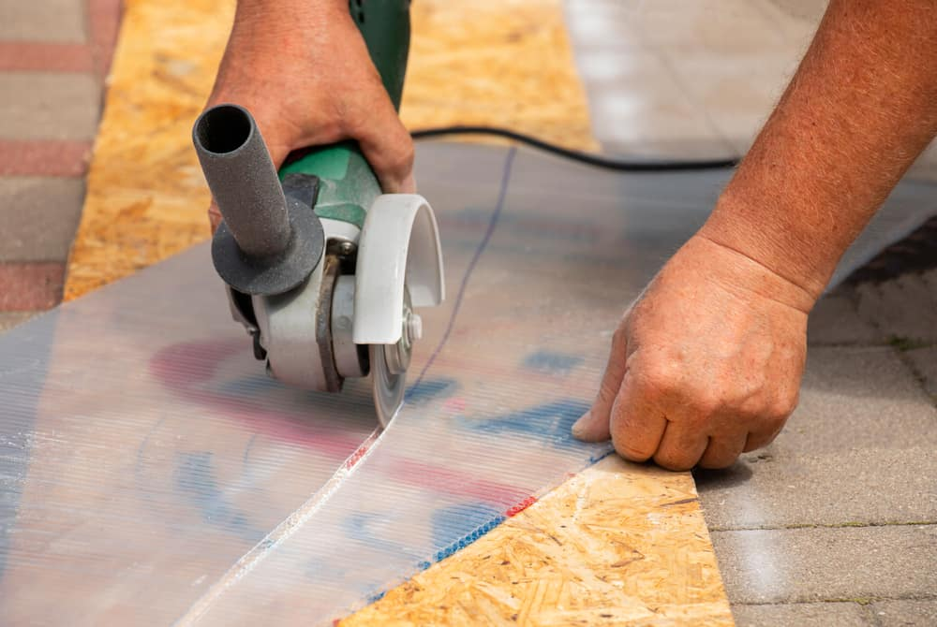
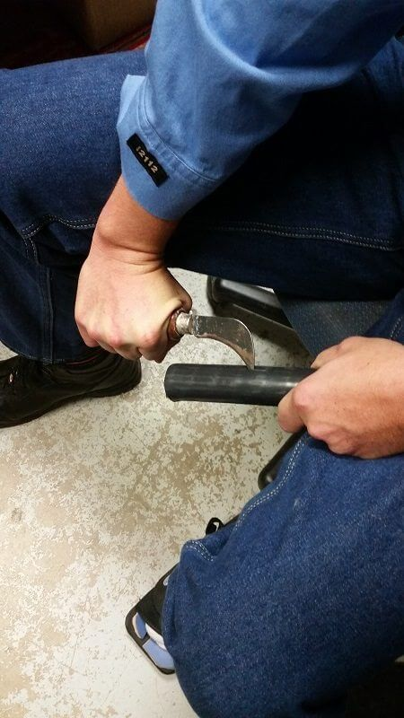



Topic: Hand Incident Prevention – Laceration Focused
Cut resistant gloves should be worn while using any type of knife. Excessive length in blade exposed allows the blade to fracture while under pressure causing a stored energy cut hazard if it fractures.
Gloves should be worn at all times while using a sharp hand tool – use of this tool should be done in areas that are not confined and allow use away from other body extremities. .
Gloves and the 2nd handle should be used while operating a grinder.
2

Slide 3
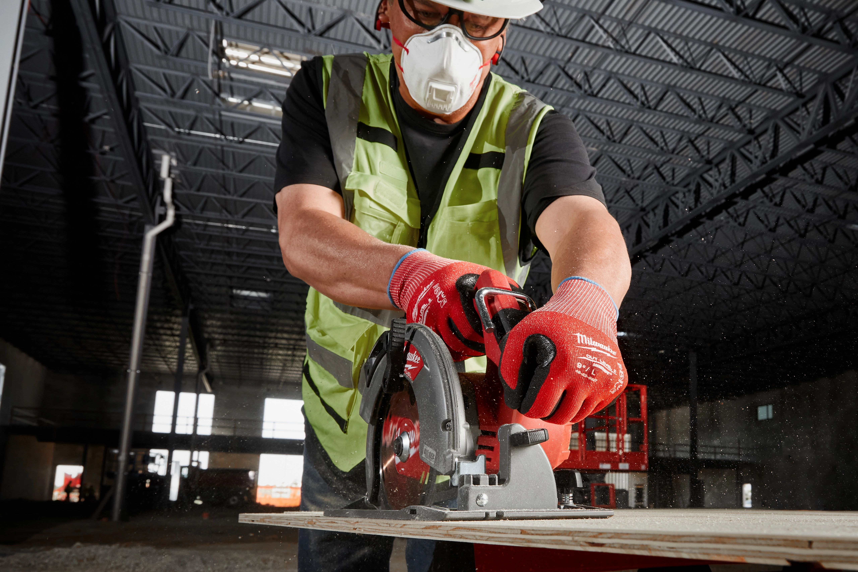
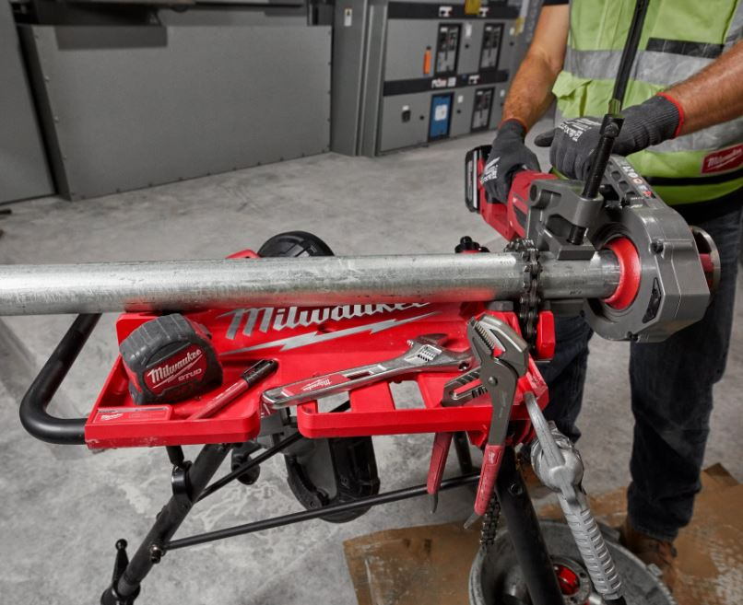
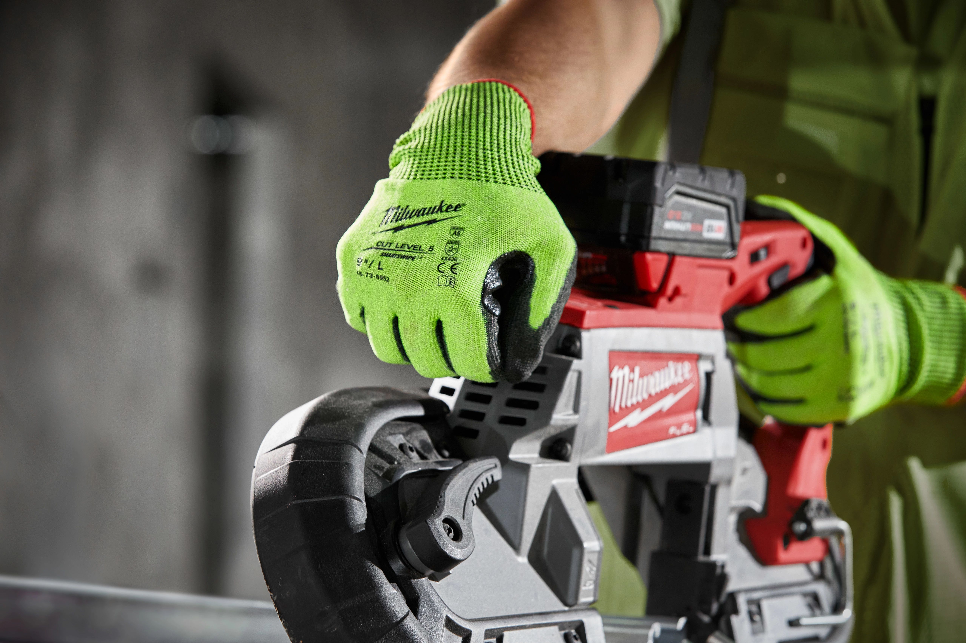
Recap
Topic: Hand Incident Prevention – Laceration Focused
Hand Placement – Use both handles at all time for safe use of tools.
Securing Material allows proper use of a tool and is key to hand incident prevention.
Dual Triggered Safety Features require both hands on the tool while in operation. Use of a secured placement of material being cut is recommended. Hold tool with both hands.
3

Slide 4

Recap
Project: |  | Supervisor
Date:
Topic: Hand Incident Prevention – Laceration focused
Hazards | Precaution
Cut / Laceration hand Injuries. | Boots on the land / gloves on the hand – more often than most, laceration and cuts to the hands occur due to job site conditions. Being prepared for all conditions in both light and lowlighted conditions is key. Cut level 4 gloves are required on most jobs by GC’s. Metal burrs on a stair railing, sharp corners on metal studs, broken wires on perimeter cables, sharp ends on drop wires in mechanical spaces – know the hazards – identify them and eliminate if possible. Use duct tape if possible.
Hand Laceration from power tool | Hand placement during tool use is very important. Sometimes blades can grab onto your gloves pulling your fingers into blades during tool use. Always keep you hand away from the blade during use, secure materials prior to cutting them with a tool, have proper training for tool use, ask for help when needed to secure materials. Remove battery / unplug prior to completing maintenance on a tool.
Hand Laceration from a hand tool | Right tool for the job. Easy to always use a utility knife to open boxes or processes as simple as sharpening a pencil. Use shears / scissors, proper blade length, hook blades for general use. Use proper pressure / avoid rushing while using any type of knife – always cutting away from you or another employee. Use a power tool, if possible, to eliminate use of sharp tools. Inspect tools prior to use.
Hand injury due to improper placement | Hand placement during material handling operations is often the reason for severe hand injuries / lacerations and sometimes amputation. Have a plan, talk it through several times before starting the operation. Use pictures to identify hand placement if possible –helps to eliminate misunderstandings. Inspecting rigging for broken wires or sharp hazards before use, identify caught between hazards, know the weight of the material your moving – always talk up a hazard before, during, and after the operation.
Crew Member’s Names

