Slide 1
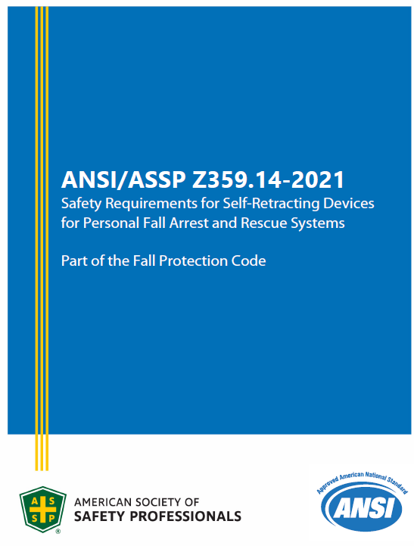
ANSI/ASSP Z359.14-2021 (SRLs)
Approved: June 17 , 2021
Published: July 6, 2021
Effective: February 1, 2023
Notes:
Disclaimer: This is going to be a high-level overview. We will not be discussing specific products or competitor products at this time. Please limit your questions to this scope

Slide 2
ANSI/ASSP Z359.14-2021 (SRLs)
2014 Classifications are gone
  SRL, SRL-R, and SRL-LE
  Class A and Class B
2021 replaces with:
  SRL, SRL-P, and SRL-R
  Class 1 and Class 2
Notes:
Disclaimer: This is going to be a high-level overview. We will not be discussing specific products or competitor products at this time. Please limit your questions to this scope

Slide 3
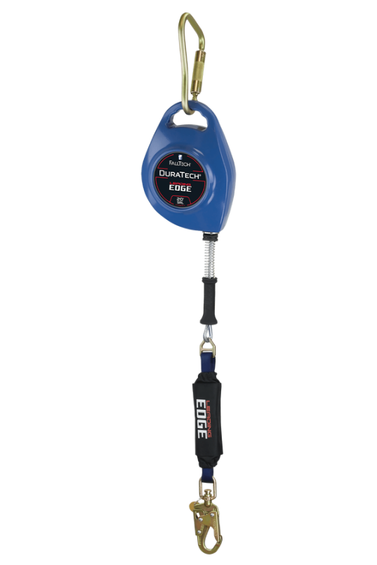
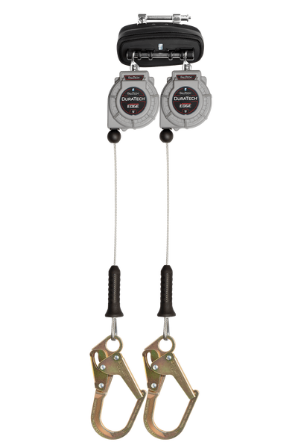
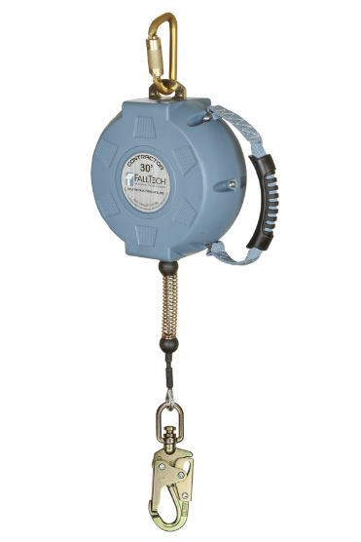
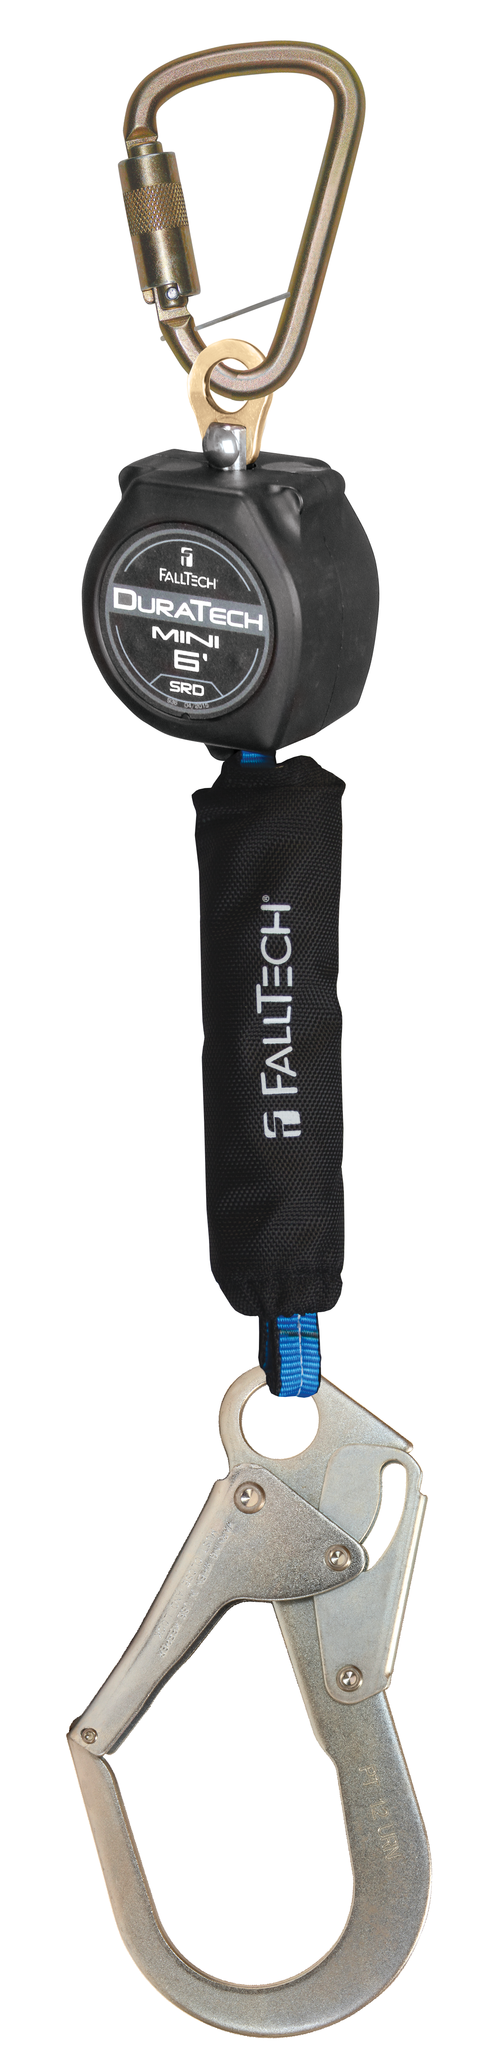
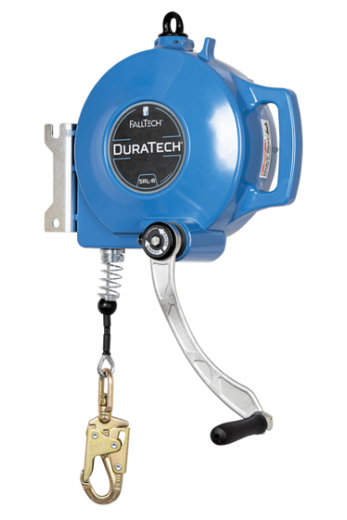
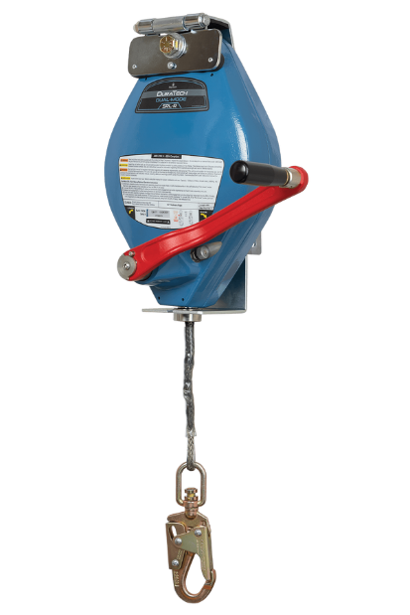
ANSI/ASSP Z359.14-2021 (SRLs)
SRL
SRL-P
SRL-R
Notes:
SRL is overhead anchorage only
SRL-P is any device that can be mounted to the back
SRL-R remains the same

Slide 4
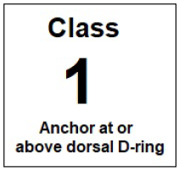
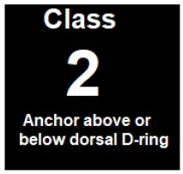

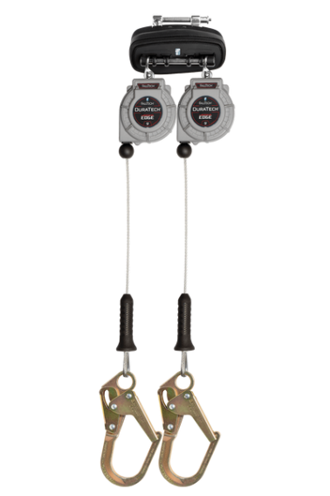
ANSI/ASSP Z359.14-2021 (SRLs)
Notes:
Class 2 is effectively the same as what we would call a Leading-Edge device today

Slide 5
2021 SRL Overhead Performance
2014 Class A & Class B
2021 Class 1 & Class 2
MAF: 1,800 lbf
AAF: 1,350lbf (A) / 900 lbf (B)
AD: 24” (A) / 54” (B)
MAF: 1,800 lbf
AAF: 1,350 lbf
AD: 42”
Notes:
Disclaimer: This is going to be a high-level overview. We will not be discussing specific products or competitor products at this time. Please limit your questions to this scope

Slide 6
ANSI/ASSP Z359.14-2021 (SRLs)
Testing requirements changes
  Test mass move up to 310 lbs. for all testing
    Previously 282 lbs. or 300 lbs.
  Static testing requirement moves up to 3,600 lbf
    Previously 3,000 lbf
    Presents a challenge to 3/16” cable design units
    Presents significant compliance challenge for Stainless Steel cable units
Notes:
Disclaimer: This is going to be a high-level overview. We will not be discussing specific products or competitor products at this time. Please limit your questions to this scope

Slide 7
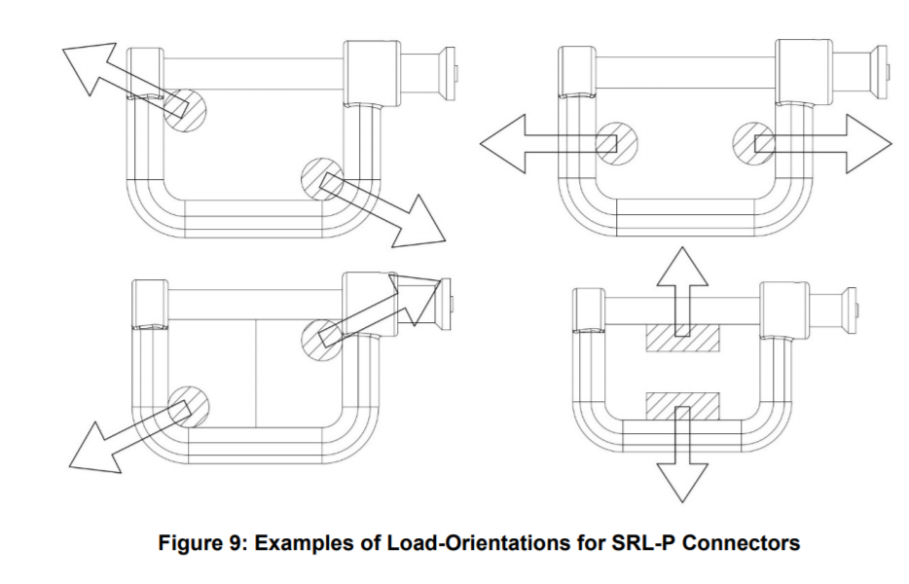
ANSI/ASSP Z359.14-2021 (SRLs)
Significantly more product testing required
  Twin SRL testing (in response to the 3M Nano-Lok Edge Recall)
  Twin SRL connectors (5073J)
  Tie-back SRL wraparound beam testing
  Tie-back SRL webbing abrasion testing
  Locked Pawl Testing
  SRL-P Misuse Testing
  Energy Capacity Testing
  And more
Notes:
Disclaimer: This is going to be a high-level overview. We will not be discussing specific products or competitor products at this time. Please limit your questions to this scope

Slide 8
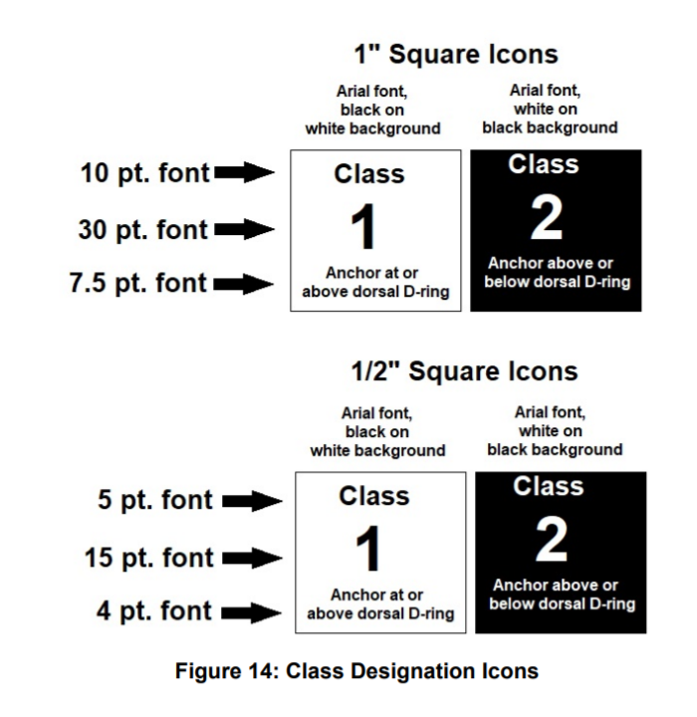
ANSI/ASSP Z359.14-2021 (SRLs)
Major changes to product labeling and markings
Unchanged:
  Leading Edge sharpness remains at 0.005”
  No provisions for testing on any substrate besides steel
    Claims for approval on other substrates (concrete) are done by manufacturer (non-standardized)
Notes:
Disclaimer: This is going to be a high-level overview. We will not be discussing specific products or competitor products at this time. Please limit your questions to this scope

Slide 9
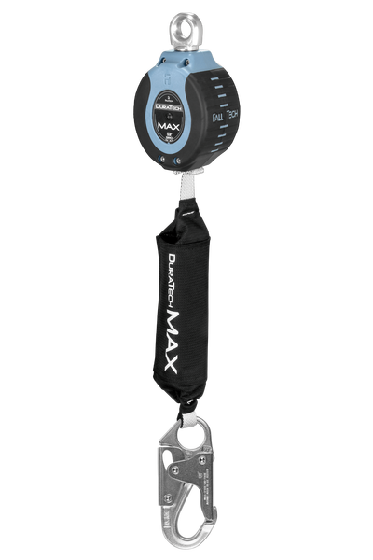
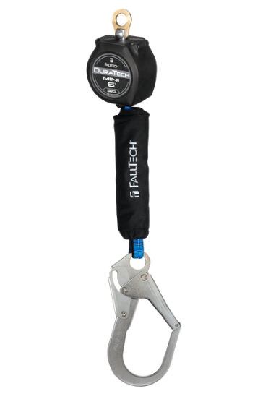
DuraTech Mini/MAX Below D-Ring Tie-Off
Both products currently permit 5’ below d-ring tie-off without edge hazards
  2021 Class 1 devices are not allowed to do that
Outside the scope of ANSI (so OSHA) allowable connection per the manufacturer
  LOI will be drafted to address and be provided when the product is qualified
  Existing MEWP LOI’s will be extended to continue to allow current practices

Slide 10
Z359 Standard Approval/Effectivity Timeline
Process is standardized as of March 2018
APPROVED
  Date that the standard is approved by Main Committee vote
PUBLISHED
  Date that the standard is published on ASSP/ANSI
  Typically 3-6 months after Approval date (reconcile comments/formatting)
EFFECTIVE
  Standard becomes effective 1 year after Publication date
  Previous versions superseded
  Date of Manufacture becomes relevant for compliance

Slide 11
ANSI/ASSP Z359.14-2021 (SRLs)
Approved: June 17 , 2021
Published: July 6, 2021
Effective: August 1, 2022
Notes:
Disclaimer: This is going to be a high-level overview. We will not be discussing specific products or competitor products at this time. Please limit your questions to this scope

