Slide 1

Harassment and respect in the workplace
Jonathan Landesman
Daniel E. Fierstein
July 21, 2020

Slide 2
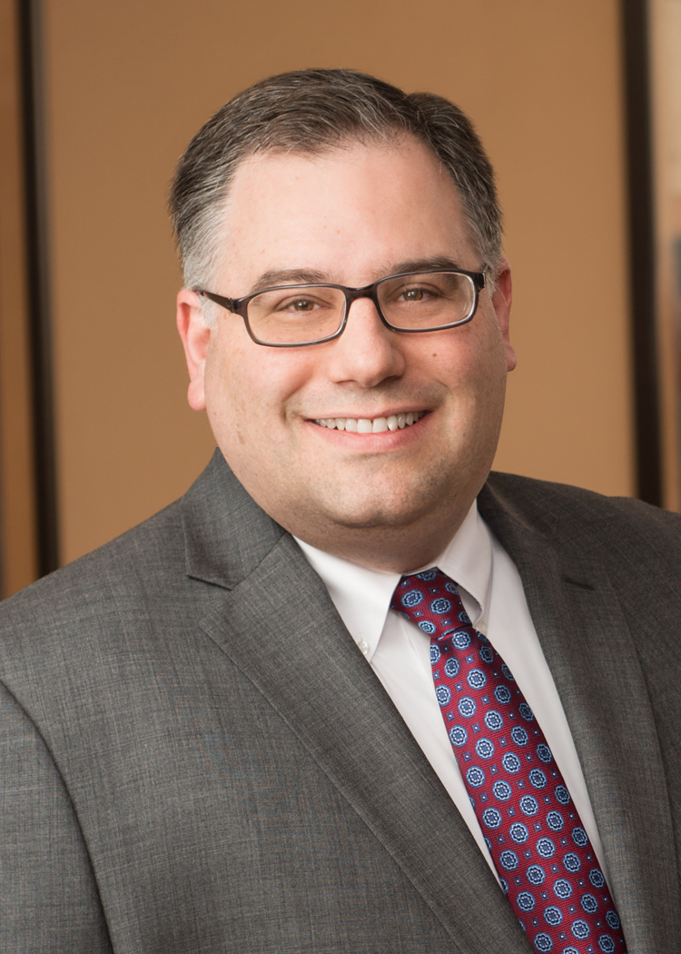
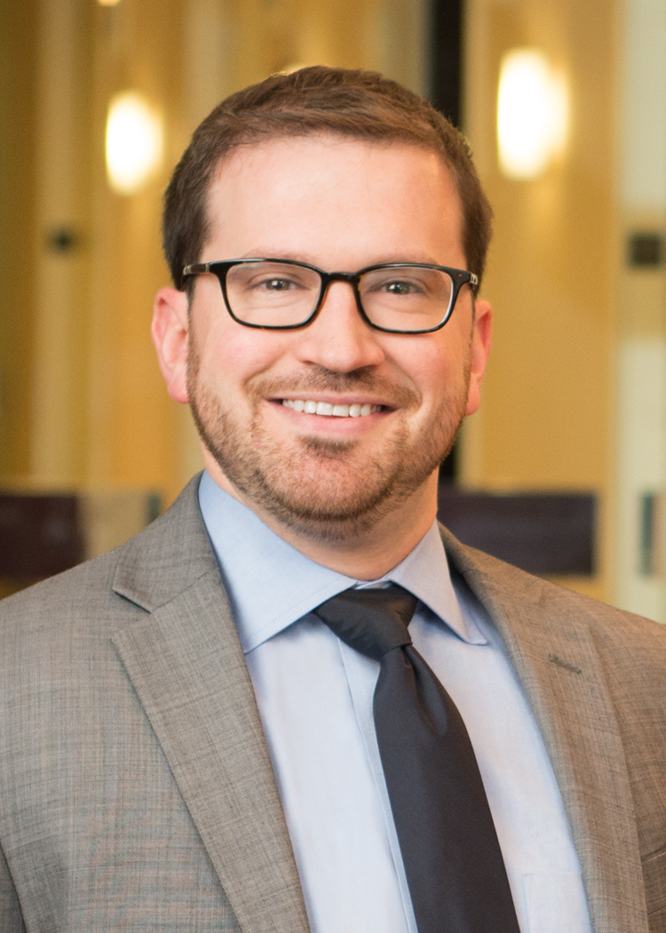
Meet the presenters
Jonathan Landesman
Labor & Employment | Cohen Seglias
Daniel E. Fierstein
Construction | Cohen Seglias

Slide 3

Laws
Federal:
Title VII of the 1964 Civil Rights Act prohibits discrimination on the basis of race, color, religion, sex, or national origin.
State:
Every state has a law that prohibits such discrimination.

Slide 4
What Kinds Of Conduct Constitute
Sexual Harassment?
Prohibited sexual harassment includes:
“Quid Pro Quo”: Explicitly or implicitly conditioning a job, raise or benefits of any kind on tolerating sexual conduct, discussions or behavior, or on a personal relationship with anyone.
“Hostile Environment”: Harassing an individual based on gender or sex to such a degree that the harassment interferes with work performance or makes working conditions intolerable.

Slide 5
Hostile Environment
To be unlawful, the harassment must be:
Severe or pervasive
Unwelcome
Objectively and subjectively offensive
And “because” of sex

Slide 6

What Kinds Of Conduct Constitute
Sexual Harassment?
To determine whether alleged conduct constitutes sexual harassment, the totality of the circumstances, the nature of the harassment and the context in which the alleged incidents occurred will be investigated.

Slide 7
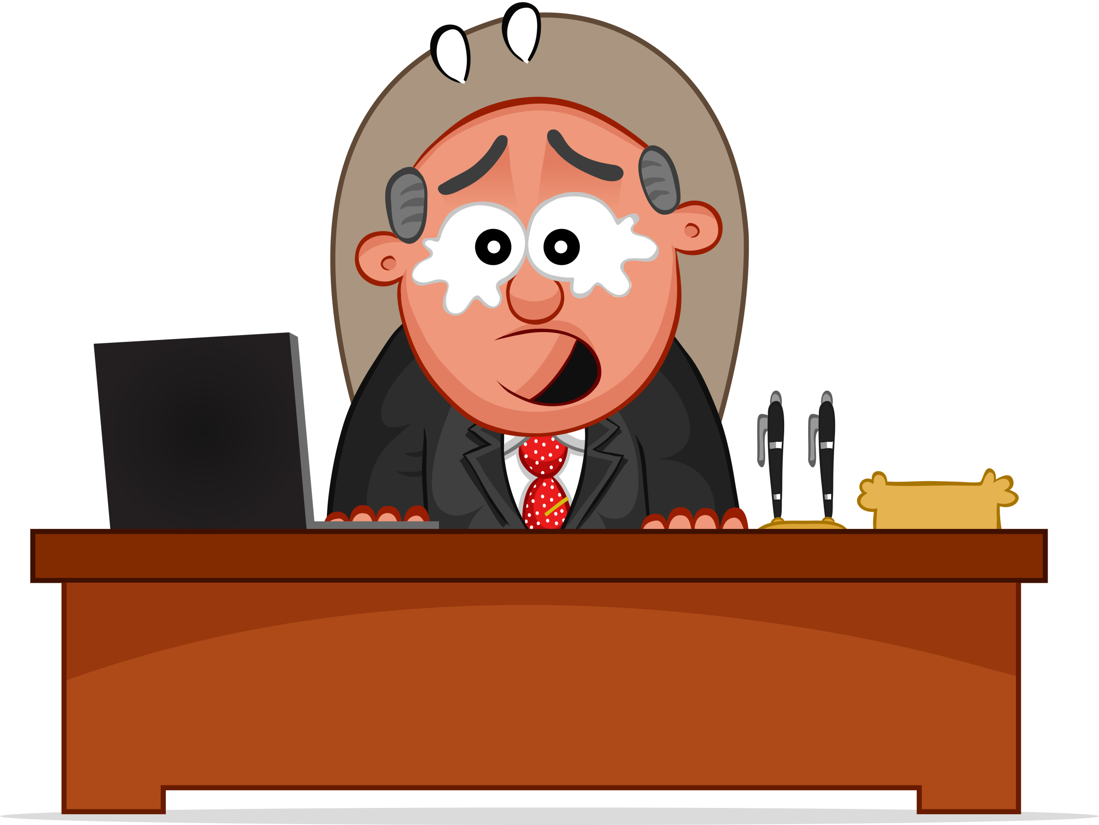
Intent is Irrelevant
What about sexual words or actions by a person who does not intend to offend or harass anyone?

Slide 8

Verbal Conduct
“HONEY”
“HUNK”
“SWEETIE”
“DOLL”

Slide 9
Nonverbal Conduct

Slide 10
Off-Color Pictures

Slide 11

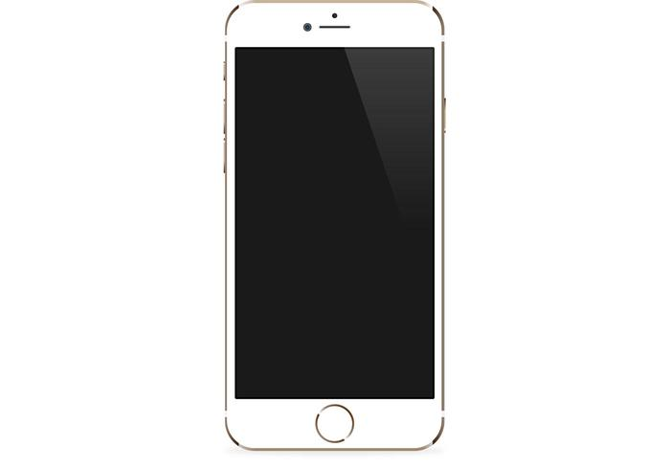


Letters/Emails/Texts

Slide 12
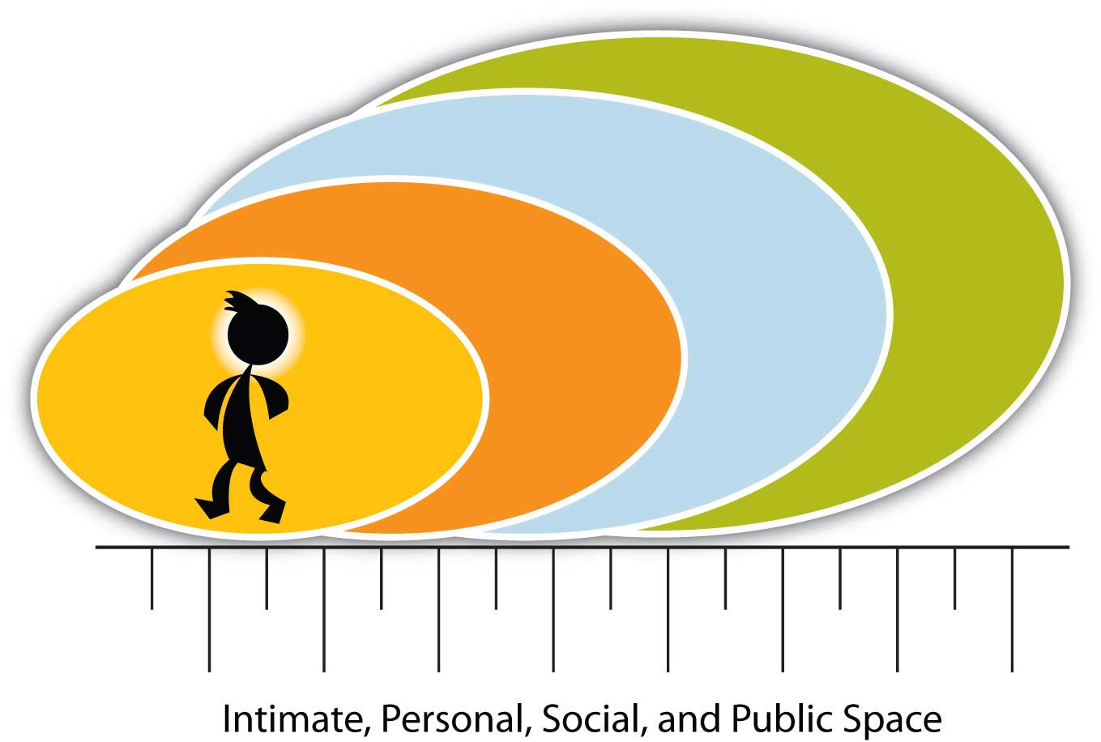
Personal Space

Slide 13
Gift Giving

Slide 14
Elevator Eyes

Slide 15

Apparel

Slide 16

Physical Contact

Slide 17
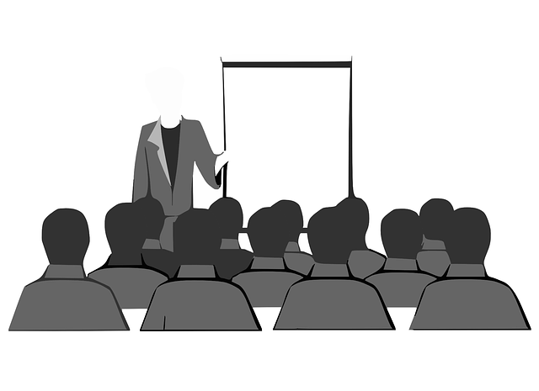
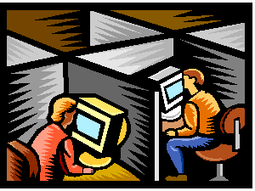
What is Considered to be the Workplace for Purposes of Sexual Harassment?
It’s not just the office.

Slide 18

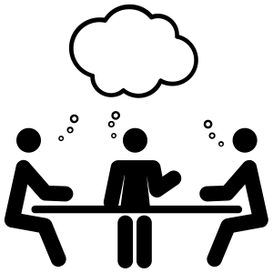

Rules for Proper Conduct Should be Observed at:
Happy Hours
Meetings &
Training Sessions
Meals with Co-Workers

Slide 19
Unwelcome

Slide 20
Offensive
Objective
Subjective
When in doubt, do not do it or say it!

Slide 21
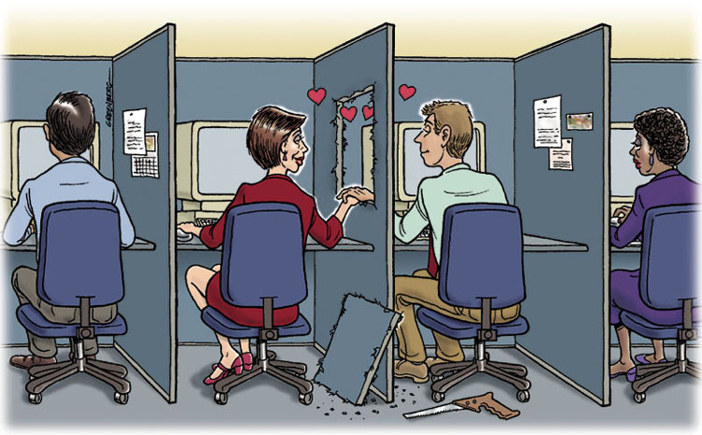
Office Romances –
WATCH OUT!

Slide 22
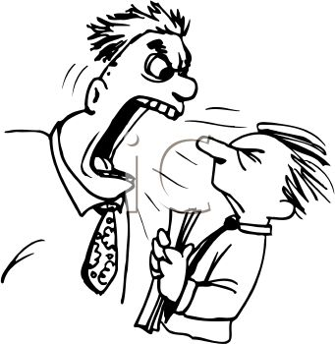
Third Party Harassment
Customers

Slide 23
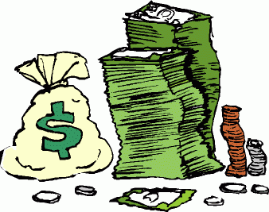
Retaliation

Slide 24

Employer Must Conduct an Investigation
And Discipline the Harasser if Appropriate

Slide 25

Hypothetical Scenarios

Slide 26

Scenario 1
I recently took an administrative job at a veterinary office. Everything has been going fine for me, except that I am bothered by the behavior of a number of my co-workers. A number of managers and colleagues seem to be involved with one another romantically. They sometimes are very demonstrative in the workplace. No one has asked me to join in any of this activity; and other than being involved in one of the relationships, my direct supervisor treats me well.

Slide 27

Scenario 2
My supervisor maintains a 3” x 5” picture of his wife in a bikini in his office. It sits on the wall directly behind him. He also has some sexually suggestive statues on his desk.

Slide 28
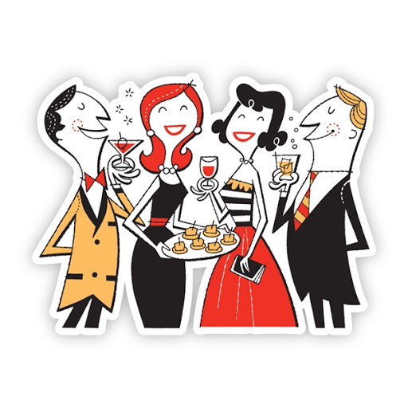
Scenario 3
I recently attended a work-related conference that included a happy hour for attendees to enjoy, including spouses and significant others. After the happy hour, I was with some colleagues having some food and drinks and one of them proceeded to get “handsy” in an unwelcome and unwanted manner.

Slide 29
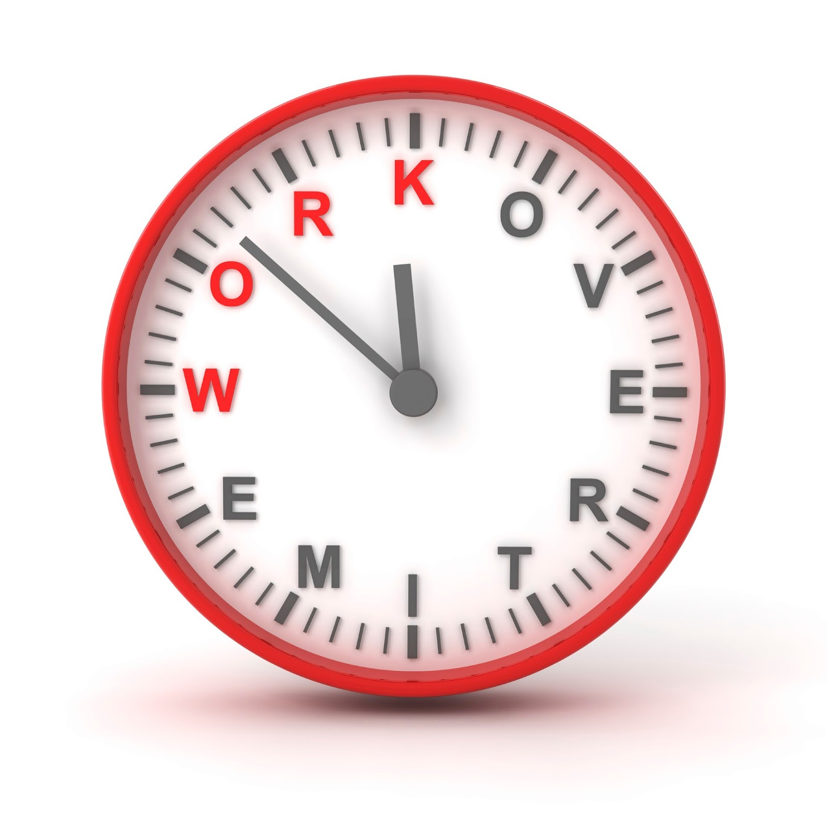
Scenario 4
Recently a young, attractive woman joined our department. She quickly became friends with our department supervisor. I noticed she has become first in line for any overtime opportunities. One of my co-workers, an older woman, who previously relied on overtime to support herself and her sick child, seems to be frozen out of overtime assignments.

Slide 30

Scenario 5
I recently joined the executive training program at a large pharmaceutical company. I have been asked to work on an exciting and sophisticated TQM project with one of the top executives in the firm. He has been very good to me in terms of explaining the company’s TQM philosophy and educating me on the company’s products and services. He asked that I put a lot of overtime and work very closely with him. He has asked me out to dinner, at which he spoke only about the business. He now tells me that he wants to finalize the project this weekend at his home. He has invited me to join him there.

Slide 31

Scenario 6
I work in the maintenance area of a commercial building. A couple of the other maintenance employees regularly read Playboy, Hustler, etc. They only do this on breaks. When one of them left some of these magazines on a break room table and a female co-worker complained, the individuals made it a point of keeping them in their locker. However, they continued to read the magazines regularly.

Slide 32

Scenario 7
Matt and Roy work as technicians in a medium sized healthcare facility. Over the years they have developed a close friendship, and they sometimes socialize on the weekends. In a joking way, Matt sometimes calls Roy the “n-word” and talks about his wife.

Slide 33
Questions?

Slide 34
Contact Information
  Jonathan Landesman
  jlandesman@cohenseglias.com
  609.668.3183
Daniel E. Fierstein
dfierstein@cohenseglias.com
215.292.4222

